Slide 1
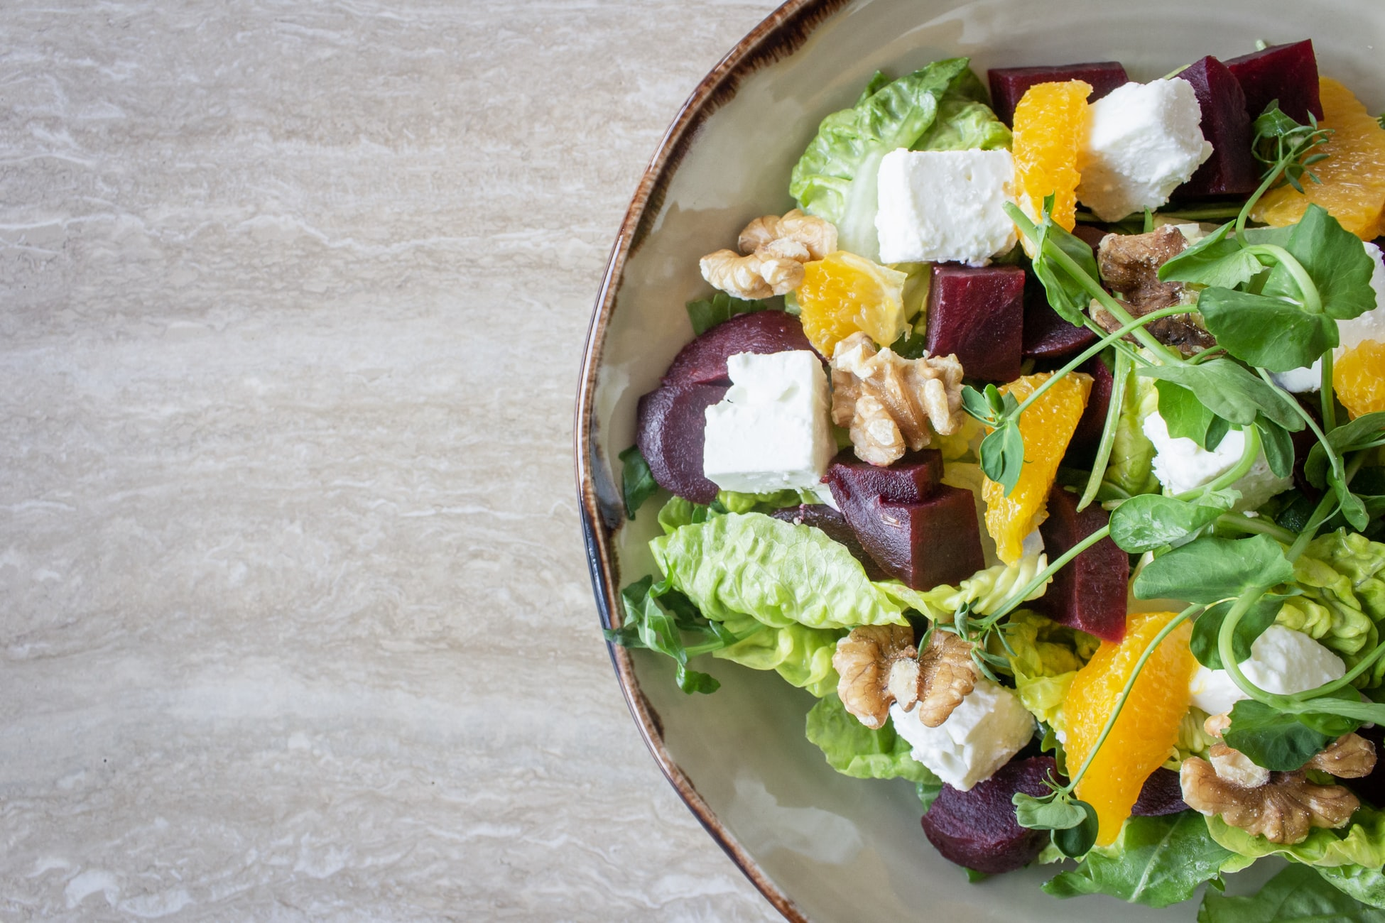
Introduction to computer science
Project Title: Recipe Page
Presented by Shalini Sinha
Project Title:
RECIPE PAGE

Slide 2
My key learnings from the course
Windows, Linux, Mac OS
Data types, Operators, Functions, Loops
MAc OS
Basics of HTML, CSS, Javascript
MAc OS
Operating System
Python
Web Development
CMD
Editors
Command Line prompt
Replit, Pycharm, code pen, visual code editor

Slide 3
Relevance in Future career
01
Technical Skill
Coding and Programming
IT project development
02
Interpersonal Skill
Communication
Team work
03
Cognitive Skill
Logical thinking
Problem solving
04
Networking
Seminar
Workshop

Slide 4
Who all wish to have their own recipe website?

Slide 5
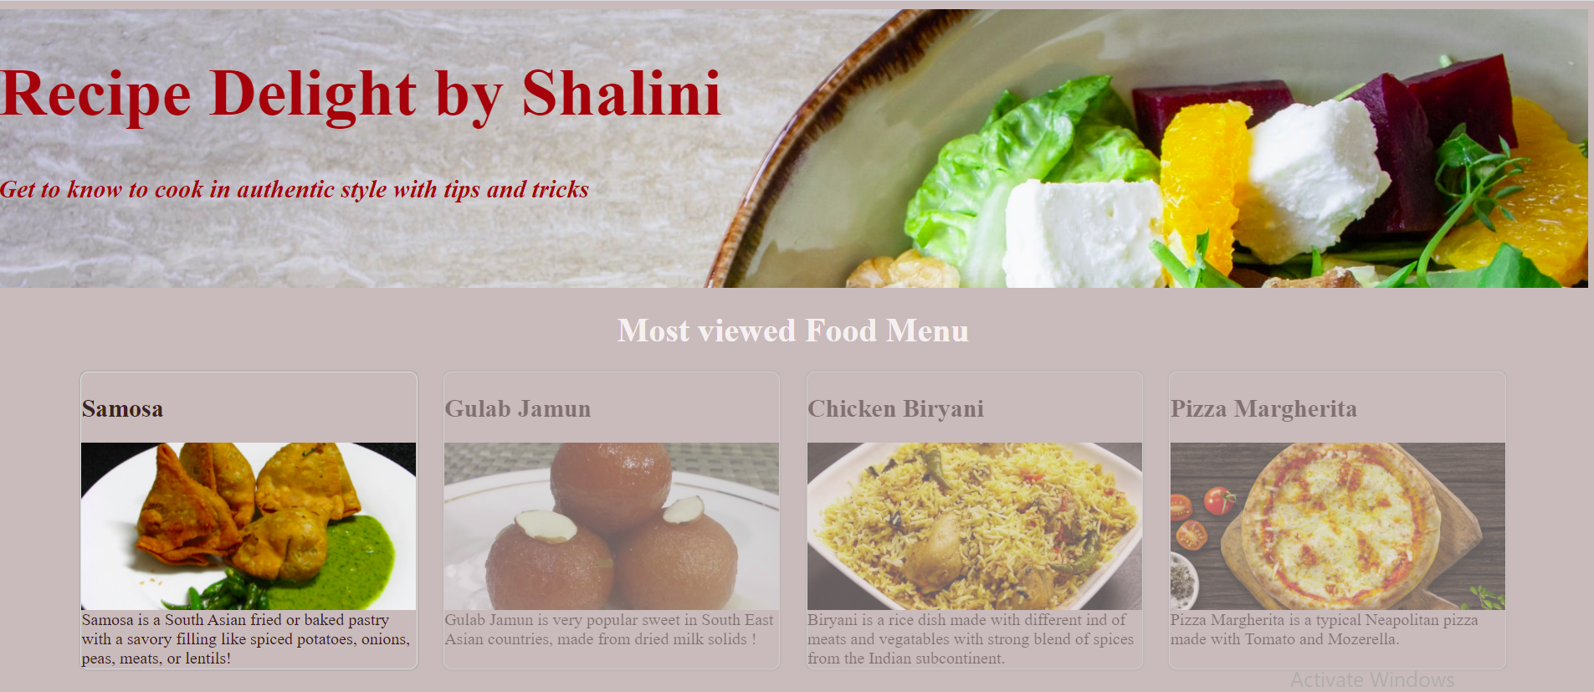
My project: Recipe Website

Slide 6


WELCOME to Shalini’s Recipe page

Slide 7
References:
https://www.w3schools.com/html/default.asp
https://github.com/shoaib-03/Recipe-Book
https://stackoverflow.com
https://unsplash.com
Redi Class material and homework

Slide 8
धन्यवाद !
Thank You
Shalini Sinha

